Slide 1
Name - Shubham kumar
Class - IX D
Roll No - 18
Student ID - 20210149588

Slide 2
Topic
Analyse different perspective on rain - calamity to joy

Slide 3
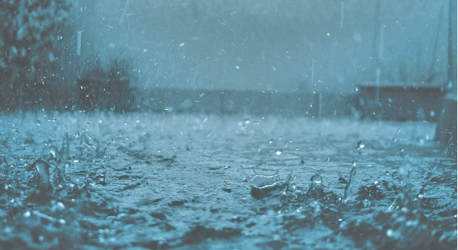
Rainy Season
I will talk about rainy season, In rainy season weather become very nice. Many people like rain but some peple dosen't like it.

Slide 4
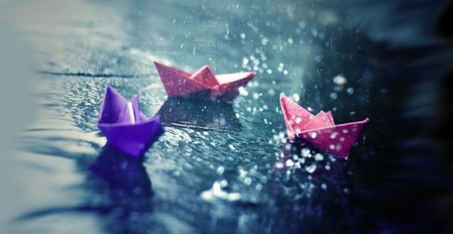
My Perspective on rain
I like rain when it comes I feel better. My mother make delicious food for me. Some children play with paper boats in rain.

Slide 5
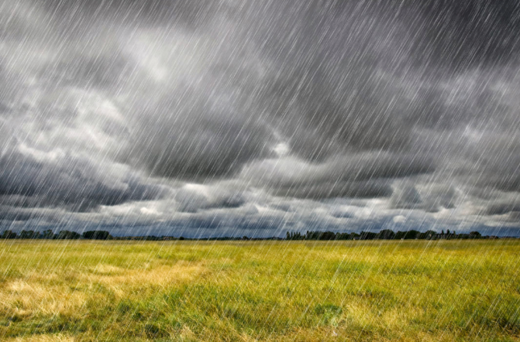
Farmers always pray for the the rain that would help for growth of crops.
In the poem 'Rain on the roof ' poet enjoys the sound of the rain

Slide 6
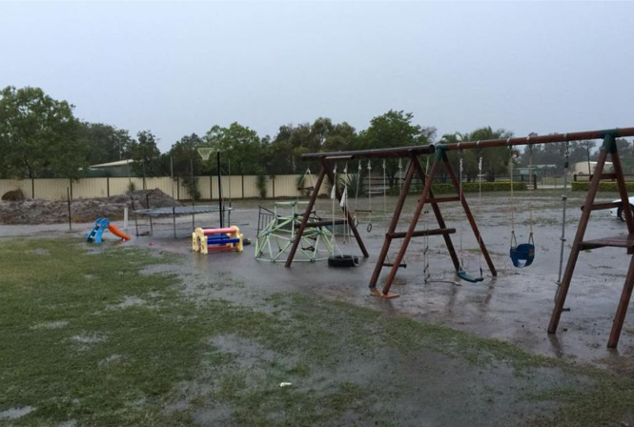
Some people doesn't like rain, those people want to play outside but they can't play outside because of heavy rainfall. Due to rain, many important works have been missed

Slide 7
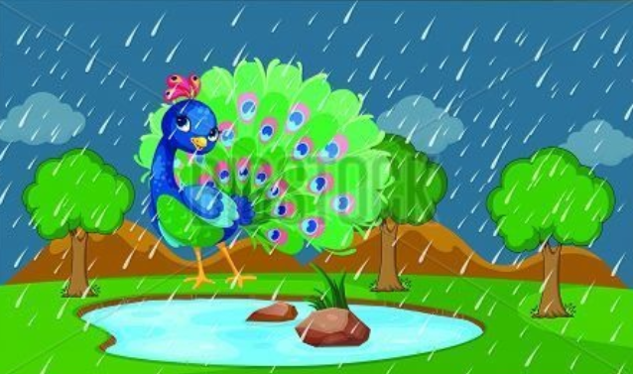
Animals also enjoy the rain like - peacock enjoy the rain by dancing. But some animals hate rains like - streets doge face problem in rain beacause they have no proper shelter to live.

Slide 8
Thank You

